Slide 1
Computer architecture 1
Inner workings of the CPu

Slide 2

Introductions
Sean Heeney
Sean.Heeney@ncirl.ie
Lecturer here at NCI for 4 years. Teaching Cloud, Cyber and Data Analytics
Previously worked in PayPal & SAP
Currently working on Blockchain Projects and Web Application Development
Interested in Computing especially Repairs and Upgrades

Slide 3
Module Overview
The aim of this module is to impart knowledge of Data Communications, Operating systems and Computer Architectures to students, as well as to provide students with the practical skills dealing with these systems.
Understanding of the internal workings of a digital computer.
Provide an introduction to the theoretical concepts addressed by operating systems and their relationship to practical systems.
Understanding at a practical level of an Operating System implementation.
Fundamental principles of data communications and the underlying technologies and applications of networks.

Slide 4
Topics from a higher level
Computer Architecture
What is a computer System
What are its main components
What is the process of communication between these components
What provides the structure to these systems

Slide 5
Topics from a higher level
Operating Systems
Investigating both Linux and Windows Operating Systems
What Exactly does and operating system provide to us ?
How do these systems differ?
How do we handle resources within a machine ?

Slide 6
Topics from a higher level
Networking
What exactly is networking ?
Establishing some of the key complexities of Networking
Its importance in modern day
The different types of communications
What about Security in Networking

Slide 7
Topics from a higher level
Virtualization and Cloud Computing
What exactly is Virtualization ?
What can virtualization provide to us
The Advent of cloud computing , the “illusion of infinite resources”
Some of the prominent CSPs – Cloud Service Providers

Slide 8
Topics from a higher level
Linux Fundamentals
Looking at the Linux OS with a more in-dept perspective
How it differs from the common Windows OS
Historical Context and its widespread use and variations
Containerization
What exactly is a container ?
How has this changed the way we use , test and deploy applications

Slide 9
Topics from a higher level
Principles of IT Security
Introduction to IT and Cyber Security
Fundamental Security Principles
Guiding bodies in the Security Domain
CSA / ENISA / OWASP / NIST
CAOSN in Industry , Trends & Bleeding Edge Technologies
Upcoming Technologies , Evolutionary and Revolutionary

Slide 10
Lets think of the Variations of Computer Systems
What Variations of computer systems do we have ?
Micro Computing
Desktop Machines
Laptops
Mobile / Smart Phones
Servers
Can you think of some up and coming / latest technologies now entering the domain ?

Slide 11
Computer Components
A computer consists of CPU, memory, and I/O components, with one or more modules of each type.
These components are interconnected in some fashion to achieve the basic function of the computer, which is to execute programs.
Notes:
Virtually all contemporary computer designs are based
on concepts developed by John von Neumann at the Institute for Advanced Studies,
Princeton. Such a design is referred to as the von Neumann architecture and is based
on three key concepts:
• Data and instructions are stored in a single read–write memory.
• The contents of this memory are addressable by location, without regard to
the type of data contained there.
• Execution occurs in a sequential fashion (unless explicitly modified) from one
instruction to the next.
The reasoning behind these concepts.There is a small set of basic logic components that can be
combined in various ways to store binary data and perform arithmetic and logical
operations on that data. If there is a particular computation to be performed, a
configuration of logic components designed specifically for that computation could
be constructed. We can think of the process of connecting the various components
in the desired configuration as a form of programming. The resulting “program” is
in the form of hardware and is termed a hardwired program.

Slide 12
Components of a modern computer
We have seen tremendous evolutions in computer technologies in recent years.
This growth has been unprecedented
Generally we see devices becoming ever more powerful and complex, but continue to shrink in size.

Slide 13
Moore’s Law
1965; Gordon Moore – co-founder of Intel
Observed number of transistors that could be put on a single chip was doubling every year
The pace slowed to a doubling every 18 months in the 1970’s but has sustained that rate ever since
Consequences of Moore’s Law:
The cost of computer logic and memory circuitry has fallen at a dramatic rate
The electrical path length is shortened, increasing operating speed
Computer becomes smaller and is more convenient to use in a variety of environments
Reduction in power and cooling requirements
Fewer interchip connections
Notes:
Figure 2.8 reflects the famous Moore’s law, which was propounded by Gordon Moore, cofounder of
Intel, in 1965 [MOOR65]. Moore observed that the number of transistors that could
be put on a single chip was doubling every year and correctly predicted that this
pace would continue into the near future. To the surprise of many, including Moore,
the pace continued year after year and decade after decade. The pace slowed to a
doubling every 18 months in the 1970s but has sustained that rate ever since.
The consequences of Moore’s law are profound:
1. The cost of a chip has remained virtually unchanged during this period of
rapid growth in density. This means that the cost of computer logic and memory
circuitry has fallen at a dramatic rate.
2. Because logic and memory elements are placed closer together on more
densely packed chips, the electrical path length is shortened, increasing
operating speed.
3. The computer becomes smaller, making it more convenient to place in a
variety of environments.
4. There is a reduction in power and cooling requirements.
5. The interconnections on the integrated circuit are much more reliable than
solder connections. With more circuitry on each chip, there are fewer interchip
connections.

Slide 14
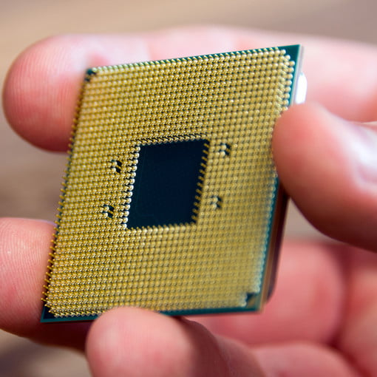
Components of a modern computer
The CPU
Central Processing Unit
We can consider this a the brain of the modern computer system
There are 2 primary manufactures within the CPU development domain
Intel & AMD

Slide 15
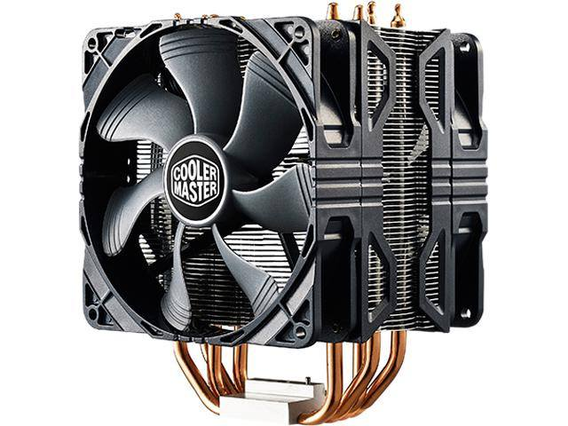
Components of a modern computer
The Heatsink
This is used to extract the tremendous amount of heat produced by the Central Processing Unit

Slide 16
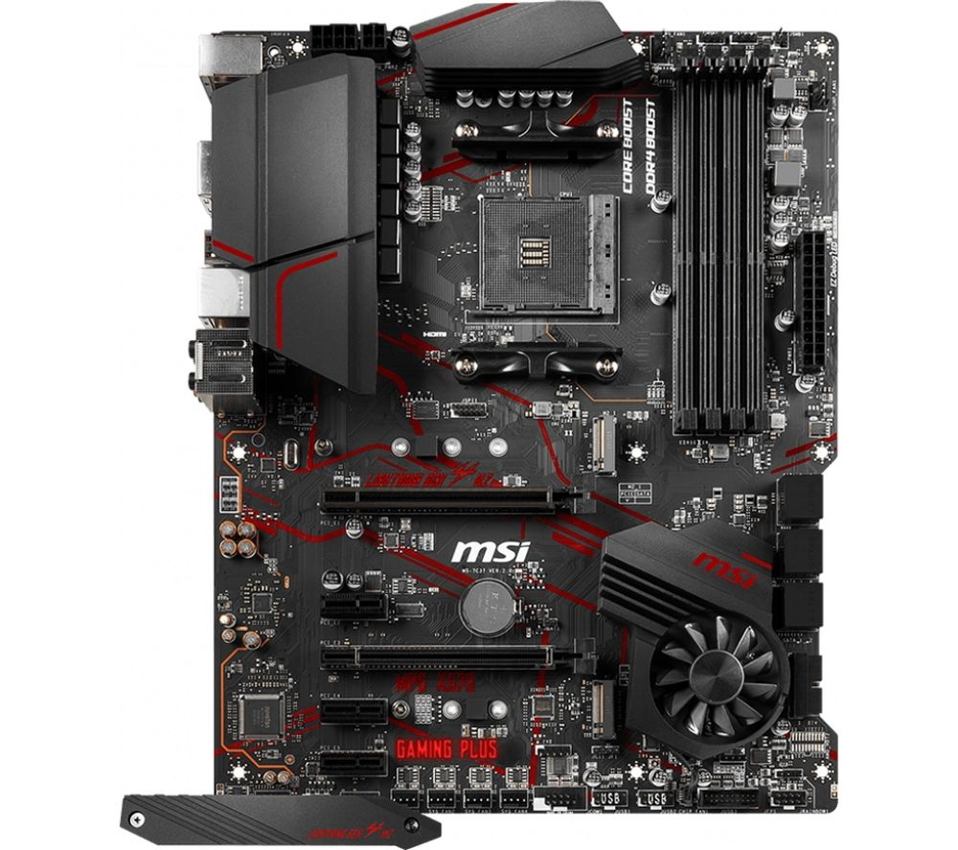
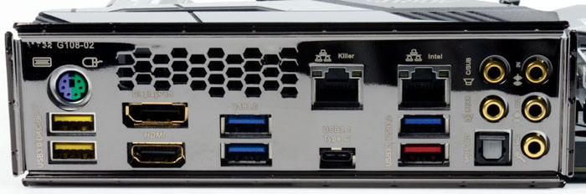
Components of a modern computer
The Motherboard
Lets consider this as the body of the system where each of the components connect to one another.
Made up on various input connectors
Lets take a closer look at some of these connectors

Slide 18
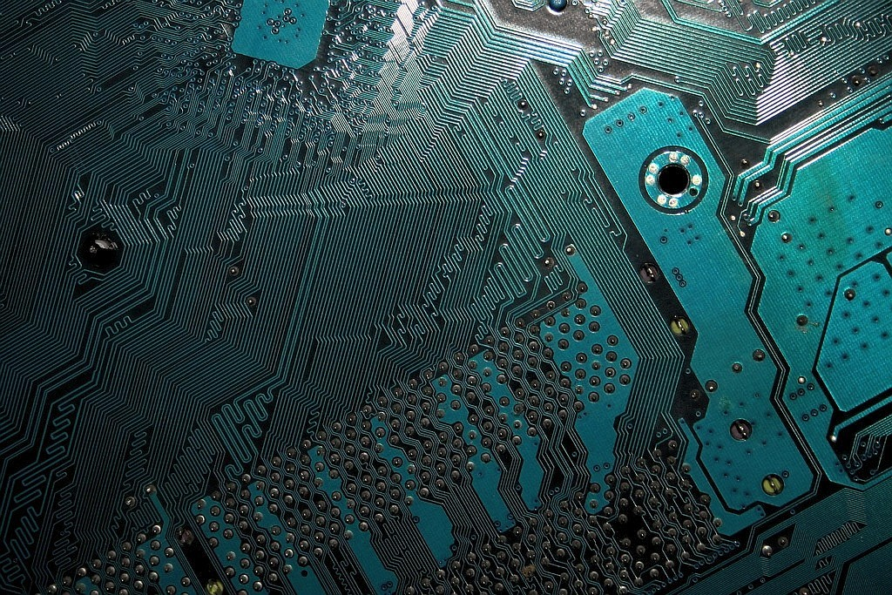
Components of a modern computer
The Bus
Consider this as the Veins of the Machine
Where data and instructions are sent from each component

Slide 19
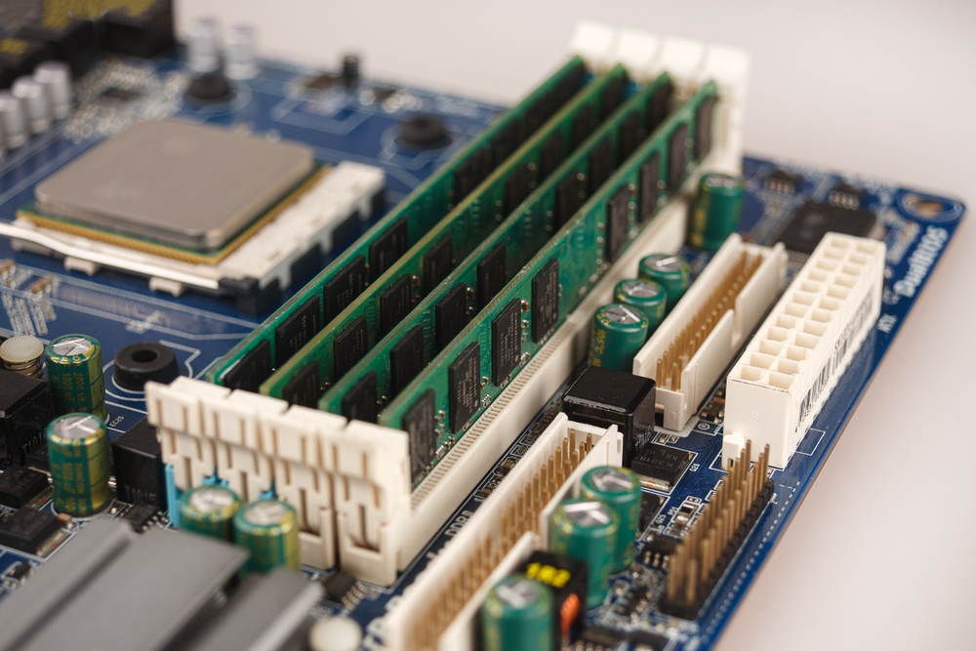
Components of a modern computer
Random Access Memory
Again lets think of the human body analogy.
Memory is used to store what are known as instructions
For example , instructions required to open a program or run a task.

Slide 20
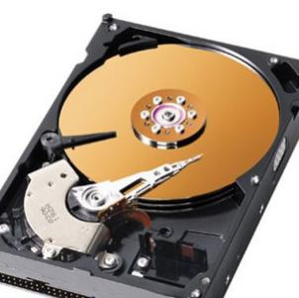
Components of a modern computer
Hard Disk Drive HDD
This is where files and data is generally stored.
We have seen tremendous evolutions in storage mechanisms in recent times.
This is considered as relatively dated technology now

Slide 21
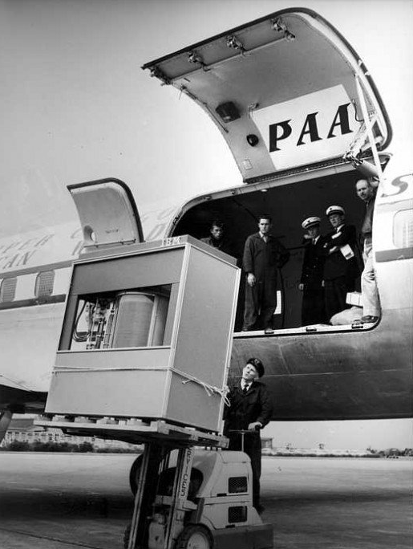
Storage Evolution
The first Hard Drive
5MB
1956
‘In September 1956 IBM launched the 305 RAMAC, the first ‘SUPER’ computer with a hard disk drive (HDD). The HDD weighed over a ton and stored 5 MB of data.’

Slide 22
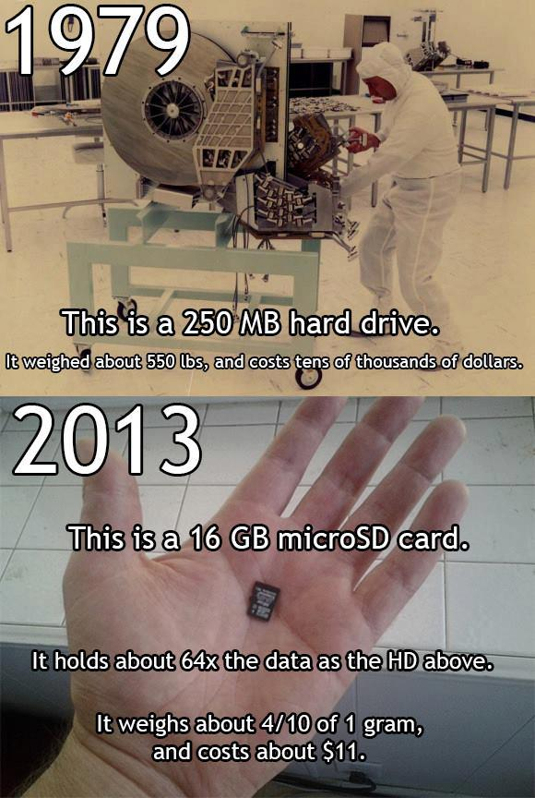
Storage Evolution

Slide 23
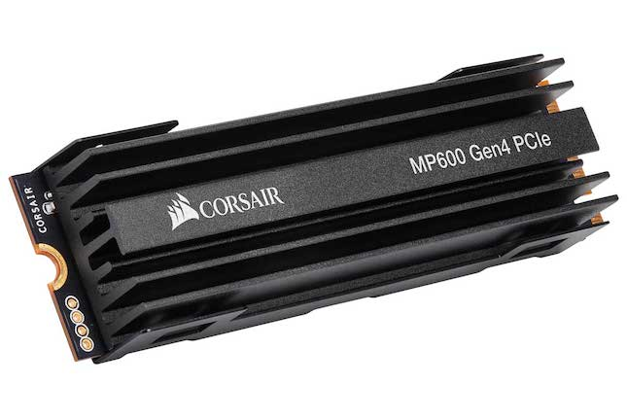
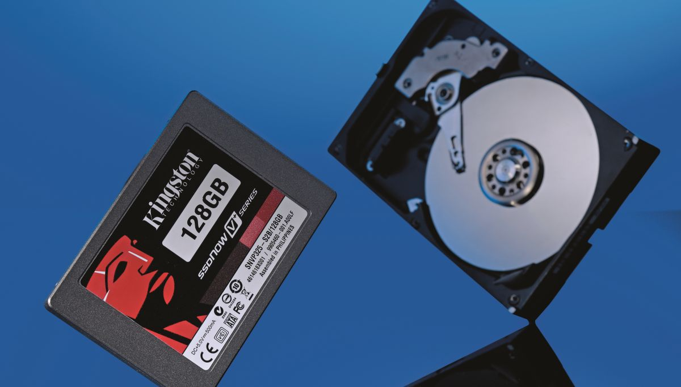
Storage Evolution

Slide 24
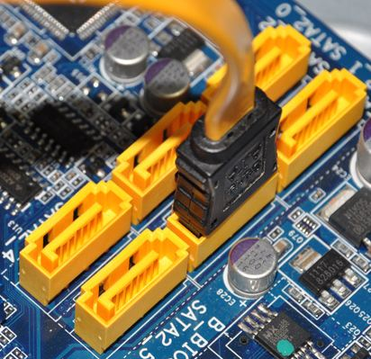
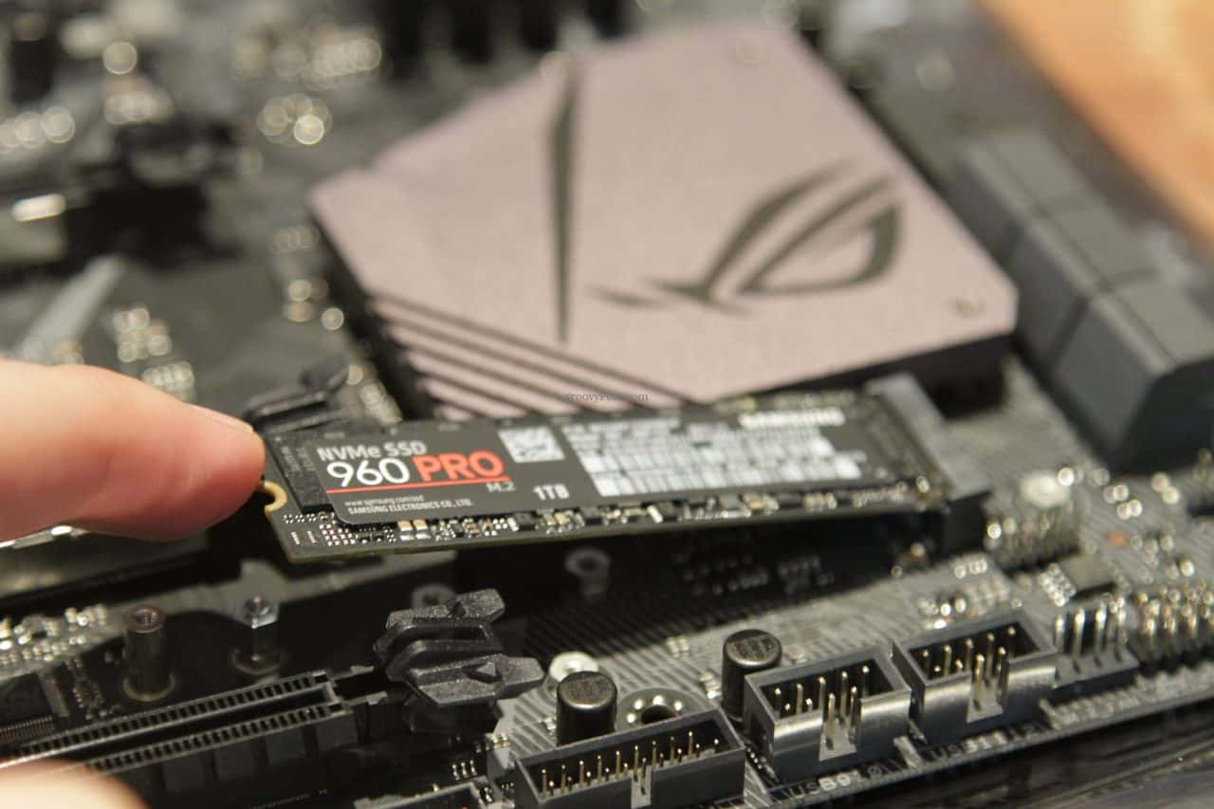
Storage Evolution
Within the Storage Arena
We have seen the removal of moving parts
Leading to better reliability and overall performance
From HDD to SSD
Even Further Development in recent times has seen the move from SSD connected through SATA - Serial Advanced Technology Attachment , now seeing storage connected directly to the motherboard

Slide 25
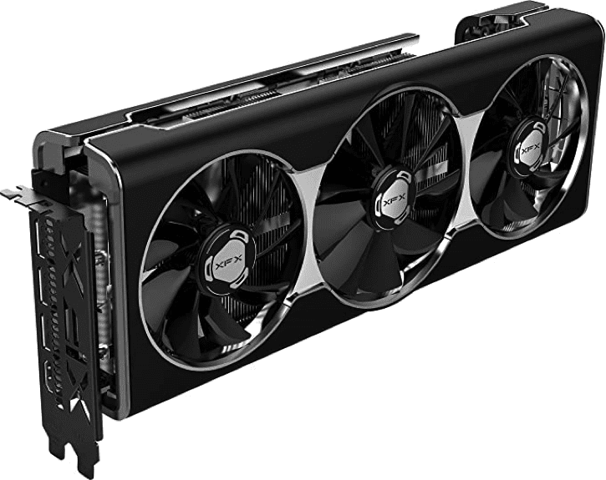
Graphics Cards
Graphics Card or GPU
Graphical Processing Unit
Used to display complex images and videos with extremely high resolutions.
4K resolutions even talk of 16K
Have become ever more complex and powerful in recent times.
Increasing in popularity - Blockchain

Slide 26

Peripherals
Varying devices used to communicate to our computer systems
Mouse / Keyboards

Slide 27
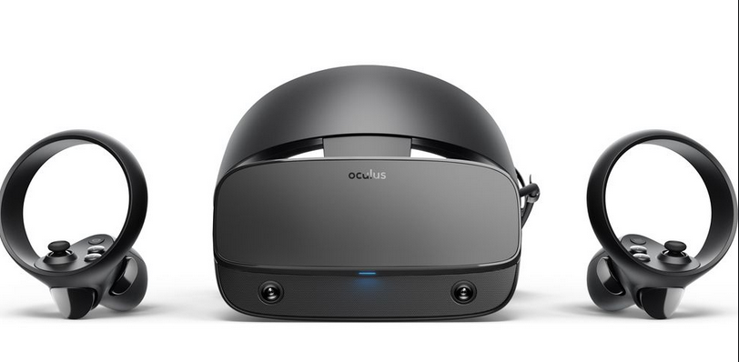
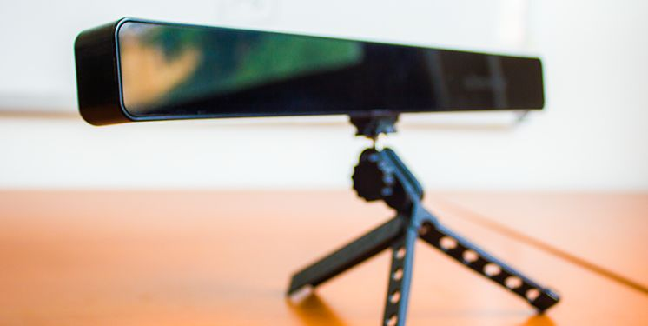
Peripherals / Cutting Edge

Slide 28
Computer Components
At a top level, we can characterize a computer system by describing
The external behavior of each component and the data and control signals that it exchanges with other components.
The interconnection structure and the controls required to manage the use of the interconnection structure.

Slide 29
Computer Components
Contemporary computer designs are based on the concepts developed by John von Neumann at the Institute for Advanced Studies, Princeton.
Referred to as the von Neumann architecture and is based on three key concepts:
Data and Instructions are stored in a single read-write memory
The contents of this memory are addressable by location, without regard to the type of data contained there
Execution occurs in a sequential fashion (unless explicitly modified) from one instruction to the next

Slide 30
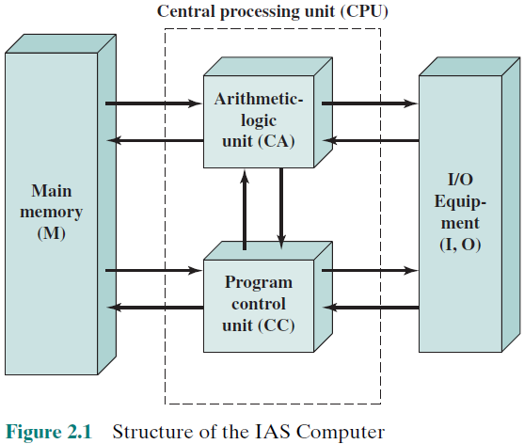
Structure of von Neumann Machine
A main memory, which stores both data and instructions.
An arithmetic and logic unit (ALU) capable of operating on binary data.
A Program control unit, which interprets the instructions in memory and causes them to be executed.
Input/output (I/O) equipment operated by the control unit.
Figure 1
Institute for Advanced Study (IAS)
Notes:
Figure 2.1 shows the general structure of the IAS computer (compare to middle
portion of Figure 1.4). It consists of
• A main memory, which stores both data and instructions
• An arithmetic and logic unit (ALU) capable of operating on binary data
• A control unit, which interprets the instructions in memory and causes them
to be executed
• Input/output (I/O) equipment operated by the control unit

Slide 31
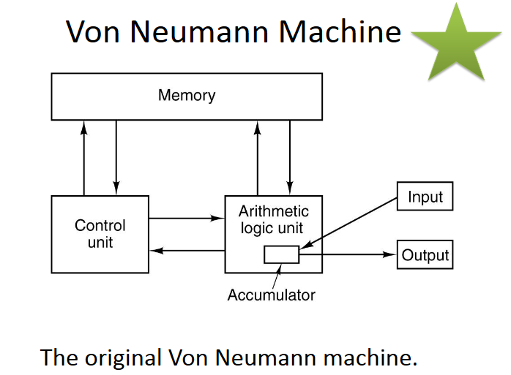

Slide 32
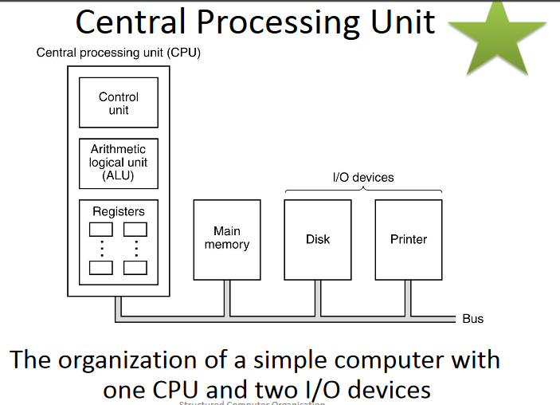

Slide 33
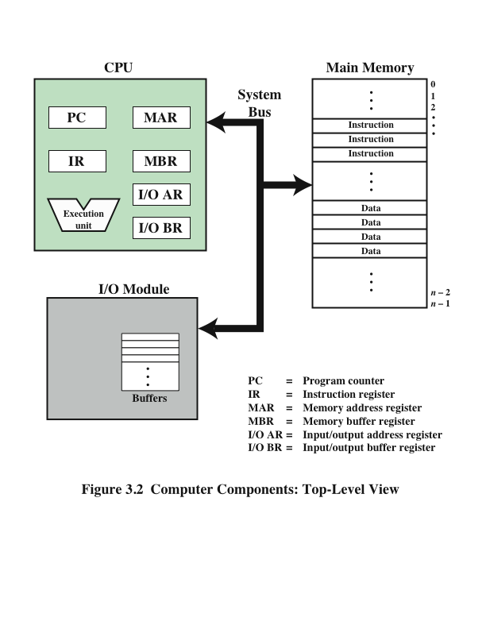
Design Principles of CPU
The hardware performs a major role to execute the program and instructions.
Use the advanced features of parallel processing to handle large number of instructions simultaneously.
The decoding and execution of the instructions must be robustly.
Large number of registers and cache memory.
The usage of memory should be in an optimal way.
Main Memory
CPU
I/O Module

Slide 34
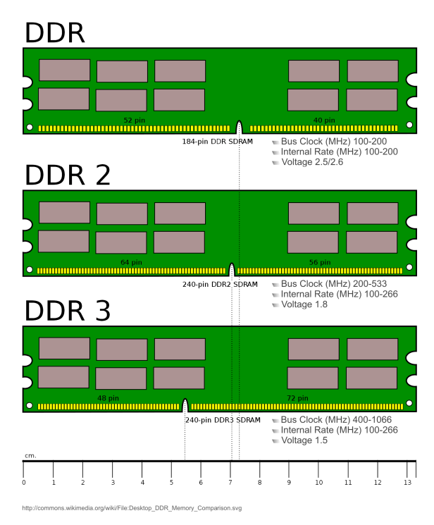
Hardware and Software Approaches
The job of input device is to bring instructions and data in the sequential order.
A program is not executed sequentially; it may jump around (e.g., the IAS jump instruction) different instructions.
Thus there must be a place to store temporarily both instructions and data. The module is called memory, or main memory, to distinguish it from external storage or peripheral devices.
Von Neumann pointed out that the same memory could be used to store both instructions and data.
Notes:
Now consider this alternative. Suppose we construct a general-purpose
configuration of arithmetic and logic functions. This set of hardware will perform
various functions on data depending on control signals applied to the hardware.
In the original case of customized hardware, the system accepts data and produces
results (Figure 3.1a). With general-purpose hardware, the system accepts data and
control signals and produces results. Thus, instead of rewiring the hardware for each
new program, the programmer merely needs to supply a new set of control signals.
How shall control signals be supplied? The answer is simple but subtle. The
entire program is actually a sequence of steps. At each step, some arithmetic or
logical operation is performed on some data. For each step, a new set of control
signals is needed. Let us provide a unique code for each possible set of control
signals, and let us add to the general-purpose hardware a segment that can accept a
code and generate control signals (Figure 3.1b).

Slide 35
I/O Components
Software
A sequence of codes or instructions
Part of the hardware interprets each instruction and generates control signals
Provide a new sequence of codes for each new program instead of rewiring the hardware
Software
Notes:
Programming is now much easier. Instead of rewiring the hardware for each
new program, all we need to do is provide a new sequence of codes. Each code
is, in effect, an instruction, and part of the hardware interprets each instruction
and generates control signals. To distinguish this new method of programming, a
sequence of codes or instructions is called software.
Figure 3.1b indicates two major components of the system: an instruction
interpreter and a module of general-purpose arithmetic and logic functions. These
two constitute the CPU. Several other components are needed to yield a functioning
computer. Data and instructions must be put into the system. For this we need some
sort of input module. This module contains basic components for accepting data
and instructions in some form and converting them into an internal form of signals
usable by the system. A means of reporting results is needed, and this is in the form
of an output module. Taken together, these are referred to as I/O components.

Slide 36
I/O Components
Major Components:
Means of reporting results
Output module
Contains basic components for accepting data and instructions and converting them into an internal form of signals usable by the system
Input module
I/O Components
Module of general-purpose arithmetic and logic functions
Instruction interpreter
CPU
Software
Notes:
Programming is now much easier. Instead of rewiring the hardware for each
new program, all we need to do is provide a new sequence of codes. Each code
is, in effect, an instruction, and part of the hardware interprets each instruction
and generates control signals. To distinguish this new method of programming, a
sequence of codes or instructions is called software.
Figure 3.1b indicates two major components of the system: an instruction
interpreter and a module of general-purpose arithmetic and logic functions. These
two constitute the CPU. Several other components are needed to yield a functioning
computer. Data and instructions must be put into the system. For this we need some
sort of input module. This module contains basic components for accepting data
and instructions in some form and converting them into an internal form of signals
usable by the system. A means of reporting results is needed, and this is in the form
of an output module. Taken together, these are referred to as I/O components.

Slide 37
Computer Components: Top Level View
CPU
Main Memory
I/O Module
It contains internal buffers for temporarily holding these data until they can be sent on.
Notes:
Figure 3.2 illustrates these top-level components and suggests the interactions
among them.
A memory module consists of a set of locations, defined by sequentially
numbered addresses. Each location contains a binary number that can be interpreted
as either an instruction or data. An I/O module transfers data from external devices
to CPU and memory, and vice versa. It contains internal buffers for temporarily
holding these data until they can be sent on.

Slide 38
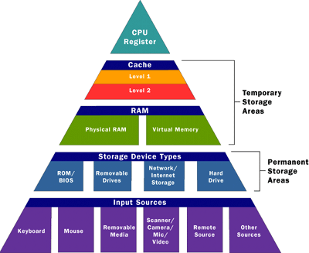
MEMORY
Memory address register (MAR)
Specifies the address in memory for the next read or write
Memory buffer register (MBR)
Contains the data to be written into memory or receives the data read from memory
I/O address register (I/OAR)
Specifies a particular I/O device
I/O buffer register (I/OBR)
Used for the exchange of data between an I/O module and the CPU
MAR
MBR
Notes:
One more component is needed. An input device will bring instructions and
data in sequentially. But a program is not invariably executed sequentially; it may
jump around (e.g., the IAS jump instruction). Similarly, operations on data may
require access to more than just one element at a time in a predetermined sequence.
Thus, there must be a place to store temporarily both instructions and data. That
module is called memory, or main memory, to distinguish it from external storage or
peripheral devices. Von Neumann pointed out that the same memory could be used
to store both instructions and data.
The CPU exchanges data with memory. For this purpose, it typically
makes use of two internal (to the CPU) registers: a memory address register (MAR),
which specifies the address in memory for the next read or write, and a memory
buffer register (MBR), which contains the data to be written into memory or receives
the data read from memory. Similarly, an I/O address register (I/OAR) specifies a
particular I/O device. An I/O buffer (I/OBR) register is used for the exchange of
data between an I/O module and the CPU.

Slide 39
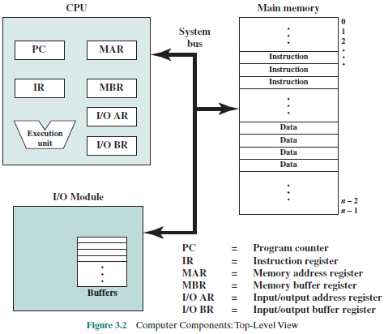
Computer Components
Figure 2 illustrates these top-level components and suggests the interactions among them.
The CPU exchanges data with memory.
For this purpose, it typically makes use of two internal (to the CPU) registers: a memory address register (MAR) and a memory buffer register (MBR), which contains the data to be written into memory or receives the data read from memory.
Figure 2
Similarly, an I/O address register (I/OAR) specifies a particular I/O device.
An I/O buffer (I/OBR) register is used for the exchange of data between an I/O module and the CPU.
Notes:
Figure 3.2 illustrates these top-level components and suggests the interactions
among them.
A memory module consists of a set of locations, defined by sequentially
numbered addresses. Each location contains a binary number that can be interpreted
as either an instruction or data. An I/O module transfers data from external devices
to CPU and memory, and vice versa. It contains internal buffers for temporarily
holding these data until they can be sent on.

Slide 40
Computer Components
A memory module consists of a set of locations, defined by sequentially numbered addresses.
Each location contains a binary number that can be interpreted as either an instruction or data.
An I/O module transfers data from external devices to CPU and memory, and vice versa.
Figure 2
In its simplest form, the instruction processing consists of two steps: The processor reads (fetches) instructions from memory one at a time and executes each instruction.
Notes:
Figure 3.2 illustrates these top-level components and suggests the interactions
among them.
A memory module consists of a set of locations, defined by sequentially
numbered addresses. Each location contains a binary number that can be interpreted
as either an instruction or data. An I/O module transfers data from external devices
to CPU and memory, and vice versa. It contains internal buffers for temporarily
holding these data until they can be sent on.

Slide 41
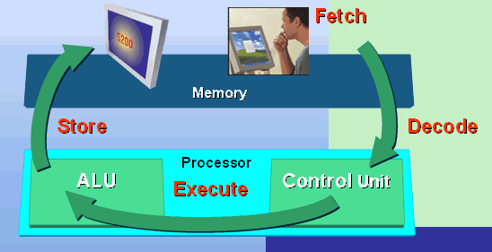
Basic Instruction Cycle
Program execution consists of repeating the process of instruction fetch and instruction execution.
The instruction execution may involve several operations and depends on the nature of the instruction.
The processing required for a single instruction is called an instruction cycle.
Notes:
Figure 3.2 illustrates these top-level components and suggests the interactions
among them.
A memory module consists of a set of locations, defined by sequentially
numbered addresses. Each location contains a binary number that can be interpreted
as either an instruction or data. An I/O module transfers data from external devices
to CPU and memory, and vice versa. It contains internal buffers for temporarily
holding these data until they can be sent on.

Slide 42
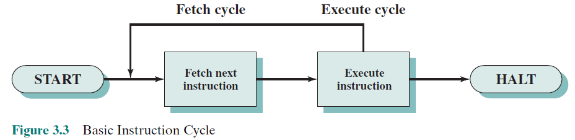
Basic Instruction Cycle
Figure 3
The processing required for a single instruction is called an instruction cycle.
Using the simplified two-step description as shown in Figure 3.
Two steps are shown to as the fetch cycle and the execute cycle.
Program execution halts only if the machine is turned off, some sort of unrecoverable error occurs, or a program instruction that halts the computer is encountered.
Notes:
In its simplest form, instruction processing
consists of two steps: The processor reads (fetches) instructions from memory one
at a time and executes each instruction. Program execution consists of repeating the
process of instruction fetch and instruction execution. The instruction execution may
involve several operations and depends on the nature of the instruction.
The processing required for a single instruction is called an instruction cycle.
Using the simplified two-step description given previously, the instruction cycle is
depicted in Figure 3.3. The two steps are referred to as the fetch cycle and the execute
cycle. Program execution halts only if the machine is turned off, some sort of unrecoverable
error occurs, or a program instruction that halts the computer is encountered.

Slide 43
Fetch Cycle
At the beginning of each instruction cycle the processor fetches an instruction from memory
The program counter (PC) holds the address of the instruction to be fetched next
The processor increments the PC after each instruction fetch so that it will fetch the next instruction in sequence
The fetched instruction is loaded into the instruction register (IR)
The processor interprets the instruction and performs the required action
Notes:
At the beginning of each instruction cycle, the processor fetches an instruction
from memory. In a typical processor, a register called the program counter (PC)
holds the address of the instruction to be fetched next. Unless told otherwise, the
processor always increments the PC after each instruction fetch so that it will fetch
the next instruction in sequence (i.e., the instruction located at the next higher memory
address). So, for example, consider a computer in which each instruction occupies
one 16-bit word of memory. Assume that the program counter is set to memory
location 300, where the location address refers to a 16-bit word. The processor will
next fetch the instruction at location 300. On succeeding instruction cycles, it will
fetch instructions from locations 301, 302, 303, and so on. This sequence may be
altered, as explained presently.
The fetched instruction is loaded into a register in the processor known as
the instruction register (IR). The instruction contains bits that specify the action
the processor is to take. The processor interprets the instruction and performs the
required action.

Slide 44
Fetch Cycle

Slide 45
Action Categories
Processor-memory
Data transferred from processor to memory or from memory to processor
Processor-I/O
Data transferred to or from a peripheral device by transferring between the processor and an I/O module
Data processing
The processor may perform some arithmetic or logic operation on data
Control
An instruction may specify that the sequence of execution be altered
https://www.youtube.com/watch?v=yi0FhRqDJfo
Notes:
In general, these actions fall into four categories:
Processor-memory: Data may be transferred from processor to memory or
from memory to processor.
• Processor-I/O: Data may be transferred to or from a peripheral device by
transferring between the processor and an I/O module.
• Data processing: The processor may perform some arithmetic or logic operation
on data.
• Control: An instruction may specify that the sequence of execution be altered.
For example, the processor may fetch an instruction from location 149, which
specifies that the next instruction be from location 182. The processor will
remember this fact by setting the program counter to 182. Thus, on the next
fetch cycle, the instruction will be fetched from location 182 rather than 150.
An instruction’s execution may involve a combination of these actions.

Slide 46
Interrupts
Program Generated by some condition that occurs as a result of an instruction execution, such as arithmetic overflow, division by zero, attempt to execute an illegal machine instruction, or reference outside a user’s allowed memory space.
Timer Generated by a timer within the processor. This allows the operating system to perform certain functions on a regular basis.
I/O Generated by an I/O controller, to signal normal completion of an operation, request service from the processor, or to signal a variety of error conditions.
Hardware Failure Generated by a failure such as power failure or memory parity error.
Notes:
Virtually all computers provide a mechanism by which other modules (I/O, memory)
may interrupt the normal processing of the processor. Table 3.1 lists the most common
classes of interrupts. The specific nature of these interrupts is examined
later in this book, especially in Chapters 7 and 14. However, we need to introduce the concept
now to understand more clearly the nature of the instruction cycle and the implications
of interrupts on the interconnection structure.

Slide 47
Interrupts
Interrupts are provided primarily as a way to improve processing efficiency.
For example, most external devices are much slower than the processor.
Suppose that the processor is transferring data to a printer using the instruction cycle scheme of Figure shown above.
After each write operation, the processor must pause and remain idle until the printer catches up.
The length of this pause may be on the order of many hundreds or even thousands of instruction cycles that do not involve memory.
Clearly, this is a very wasteful use of the processor.
Notes:
Virtually all computers provide a mechanism by which other modules (I/O, memory)
may interrupt the normal processing of the processor. Table 3.1 lists the most common
classes of interrupts. The specific nature of these interrupts is examined
later in this book, especially in Chapters 7 and 14. However, we need to introduce the concept
now to understand more clearly the nature of the instruction cycle and the implications
of interrupts on the interconnection structure.

Slide 48
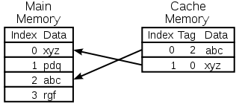
Cache Memory
Cache is a component that stores data so future requests for that data can be served faster.
A cache hit occurs when the requested data can be found in a cache, while a cache miss occurs when it cannot. Cache has three levels
L1 – Fatest
L2 – Less Fast
L3 – Slowest
Imagine like eating a food, bag of clips like L1, L2 like a kitchen and kitchen is much larger and takes more time to find. L3 is the backward storage and needs more time to find.

Slide 49
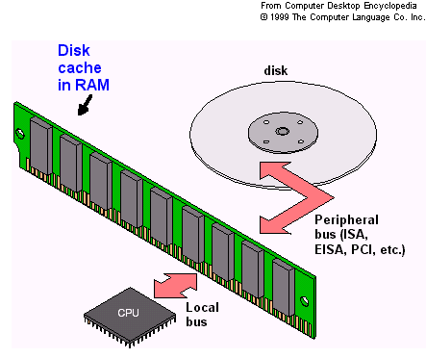
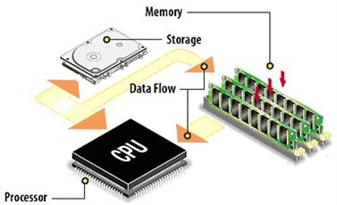
Cache Memory
Caches are generally the top level or levels of the memory hierarchy.
The main structural difference between a cache and other levels in the memory hierarchy is that caches contain hardware to track the memory addresses that are contained in the cache and to move data into and out of cache as necessary.
Lower levels of memory requires a software or a combination of hardware and software to perform this function.

Slide 50
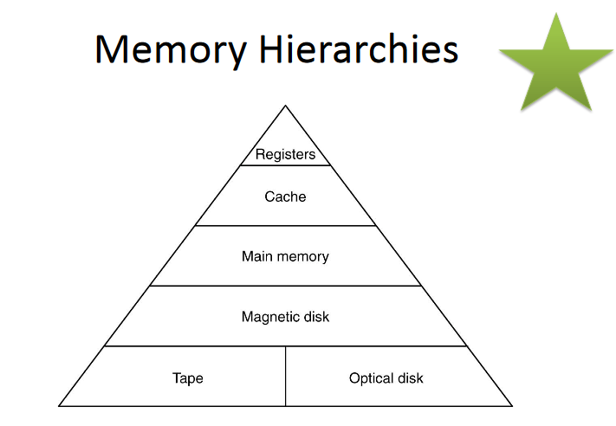

Slide 51
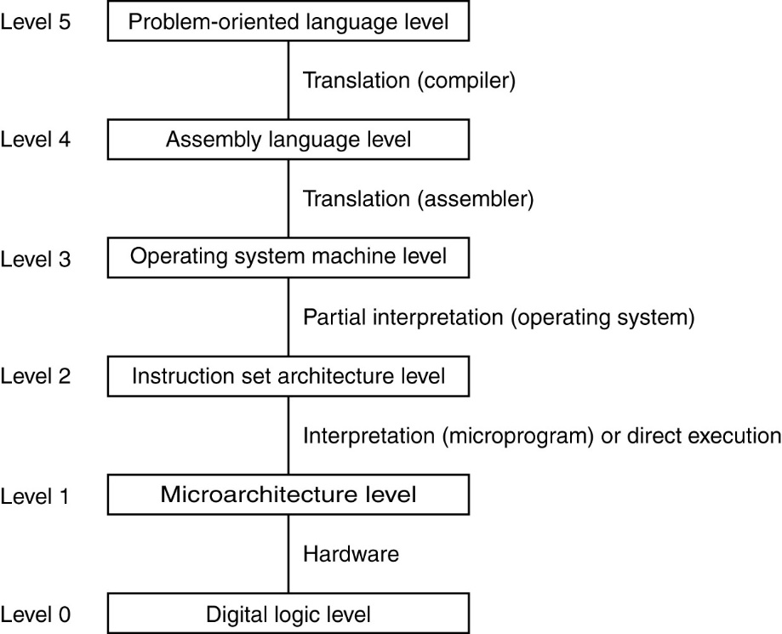
Contemporary Multi-level Computer Architecture

